Slide 1
Welcome to Langtoft Primary School

Slide 3
KINGSWOOD 2021
Purpose of meeting:
Outline the visit
Cost
Questions/Next steps

Slide 4
KINGSWOOD 2021
When? Wednesday 6 to Friday 8 October 2021
Where? Kingswood Peak Venture, South Yorkshire
Why? 1) Outdoor and Adventurous element of P.E. 2) personal and social development
How? Coach of Langtoft
Who? Mrs Wells and Mrs Smith, some of the 1:1 TAs, Mr Dolby

Slide 5
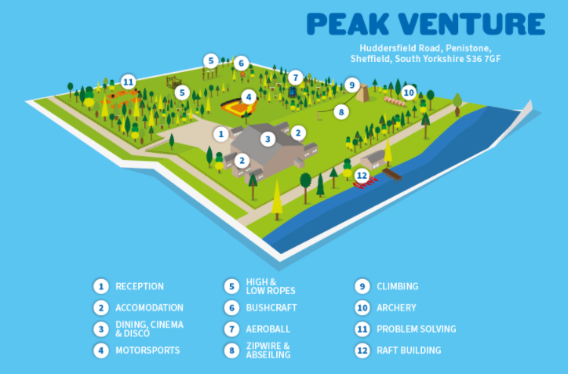
KINGSWOOD 2021

Slide 6
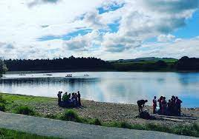
KINGSWOOD 2021
Activities

Slide 7
KINGSWOOD 2021

Slide 8
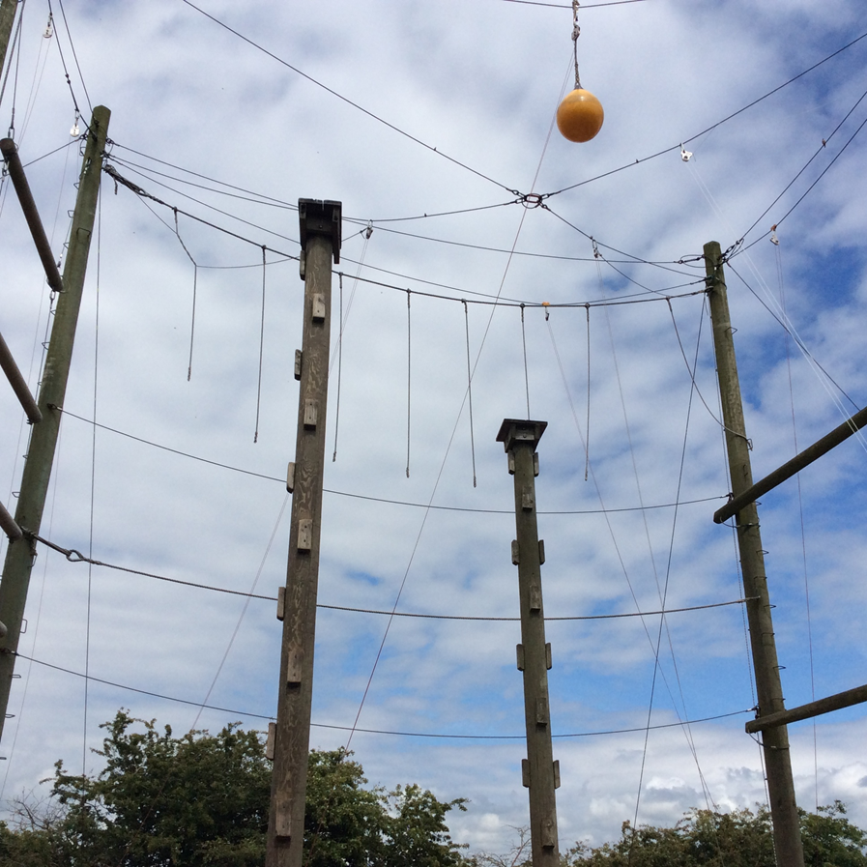
KINGSWOOD 2021

Slide 9
KINGSWOOD 2021

Slide 10
KINGSWOOD 2021

Slide 11
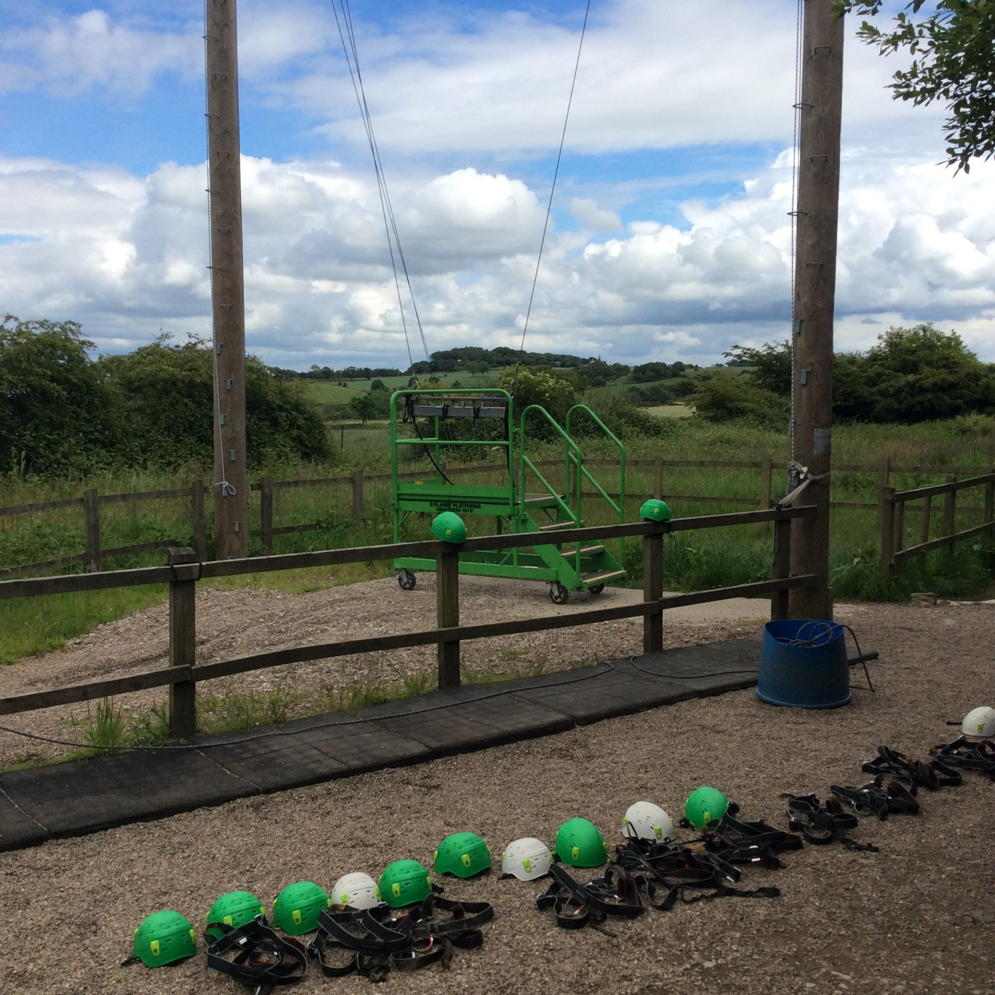
KINGSWOOD 2021

Slide 12
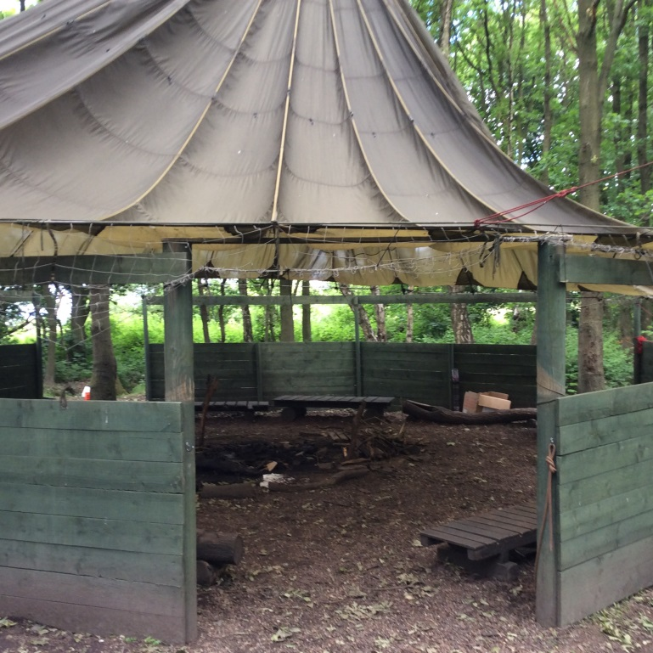
KINGSWOOD 2021

Slide 13
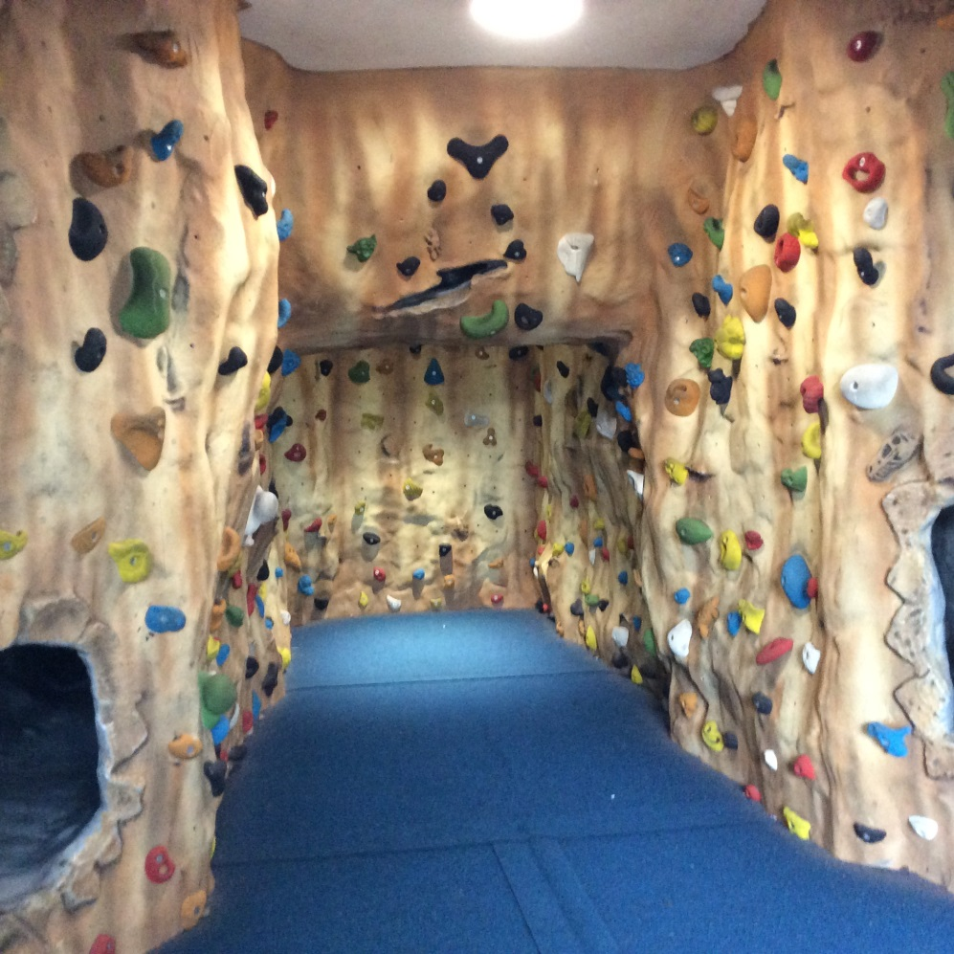
KINGSWOOD 2021

Slide 14
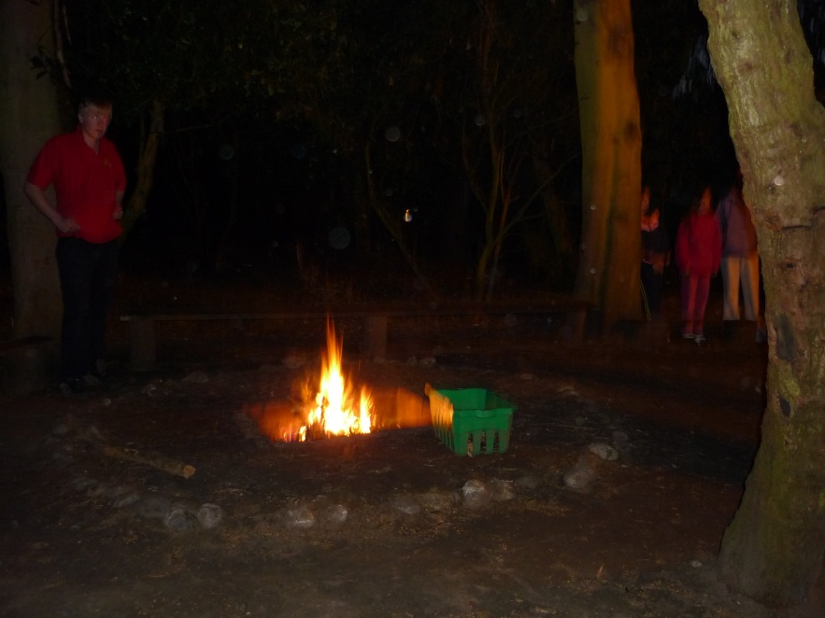
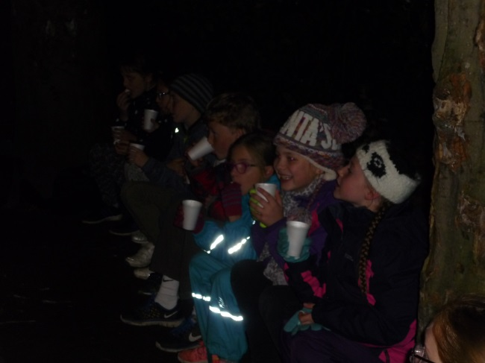
KINGSWOOD 2021
Evening Ents

Slide 15
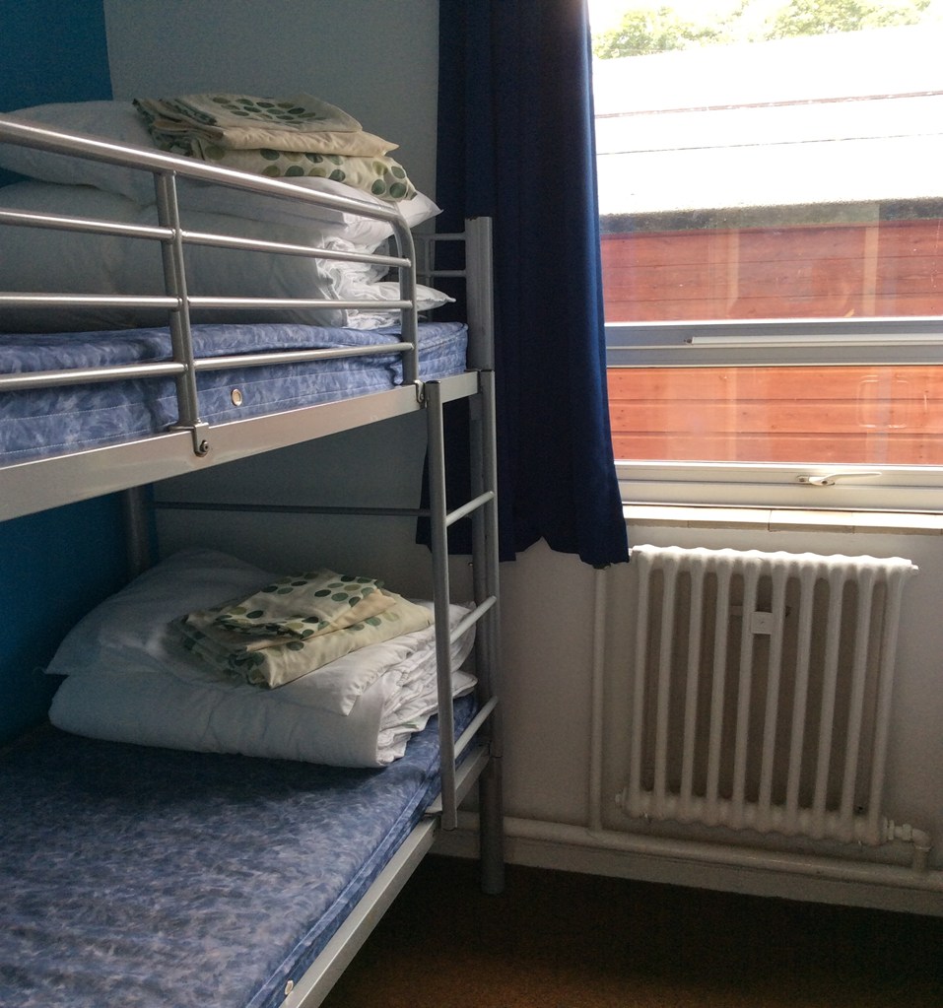
KINGSWOOD 2021
Accommodation

Slide 16
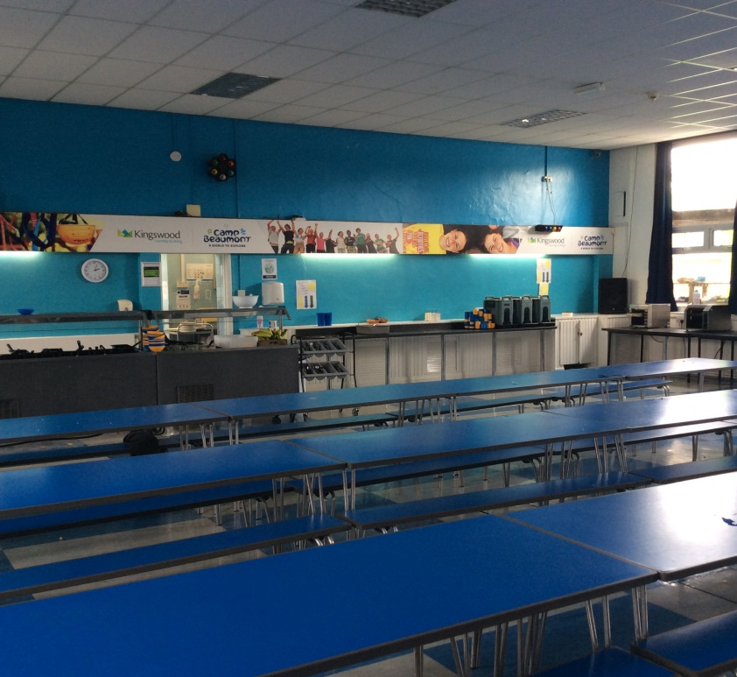
KINGSWOOD 2021

Slide 17
cereals
orange squash
fresh fruit scrambled egg fruit yoghurts white & brown toast grilled bacon, scrambled egg, sausage,
tomato,
mushroom, spaghetti hoops, baked beans
Breakfast
KINGSWOOD 2021
Lunch spicy cajun chicken
spaghetti bolognese cheese and onion pasty baked jacket potatoes baked beans grated cheese saute potatoes vegetables salad bar
fresh fruit
Dinner homemade lasagne toad in the hole chicken curry
sweet and sour chicken
cottage pie
chipped potatoes vegetables mayonnaise & sauces salad bar syrup sponge and custard
apple crumble and custard
ice cream
fresh fruit
Food

Slide 18
KINGSWOOD 2021
Q?

Slide 19
KINGSWOOD 2021
Risk Assessment
Approval from Head, Governing Body and Local Authority
‘high’ risk rating
Identified risks/hazards;
slips, trips and falls
residential
travel
water

Slide 20
KINGSWOOD 2021
Q?

Slide 21
KINGSWOOD 2021
Cost
Board and lodgings £162.50
Transport £28.50
Total £191.00
Deposit of £50 by Monday 12 July, please
Balance of £141 paid in full by 13 September

Slide 22
KINGSWOOD 2021
Q?

Slide 23
KINGSWOOD 2021
Next Steps…
Permission/deposit
Approved by Local Authority
‘Kit List’ six weeks before
Requests for dormitories and day groups week before

Slide 24
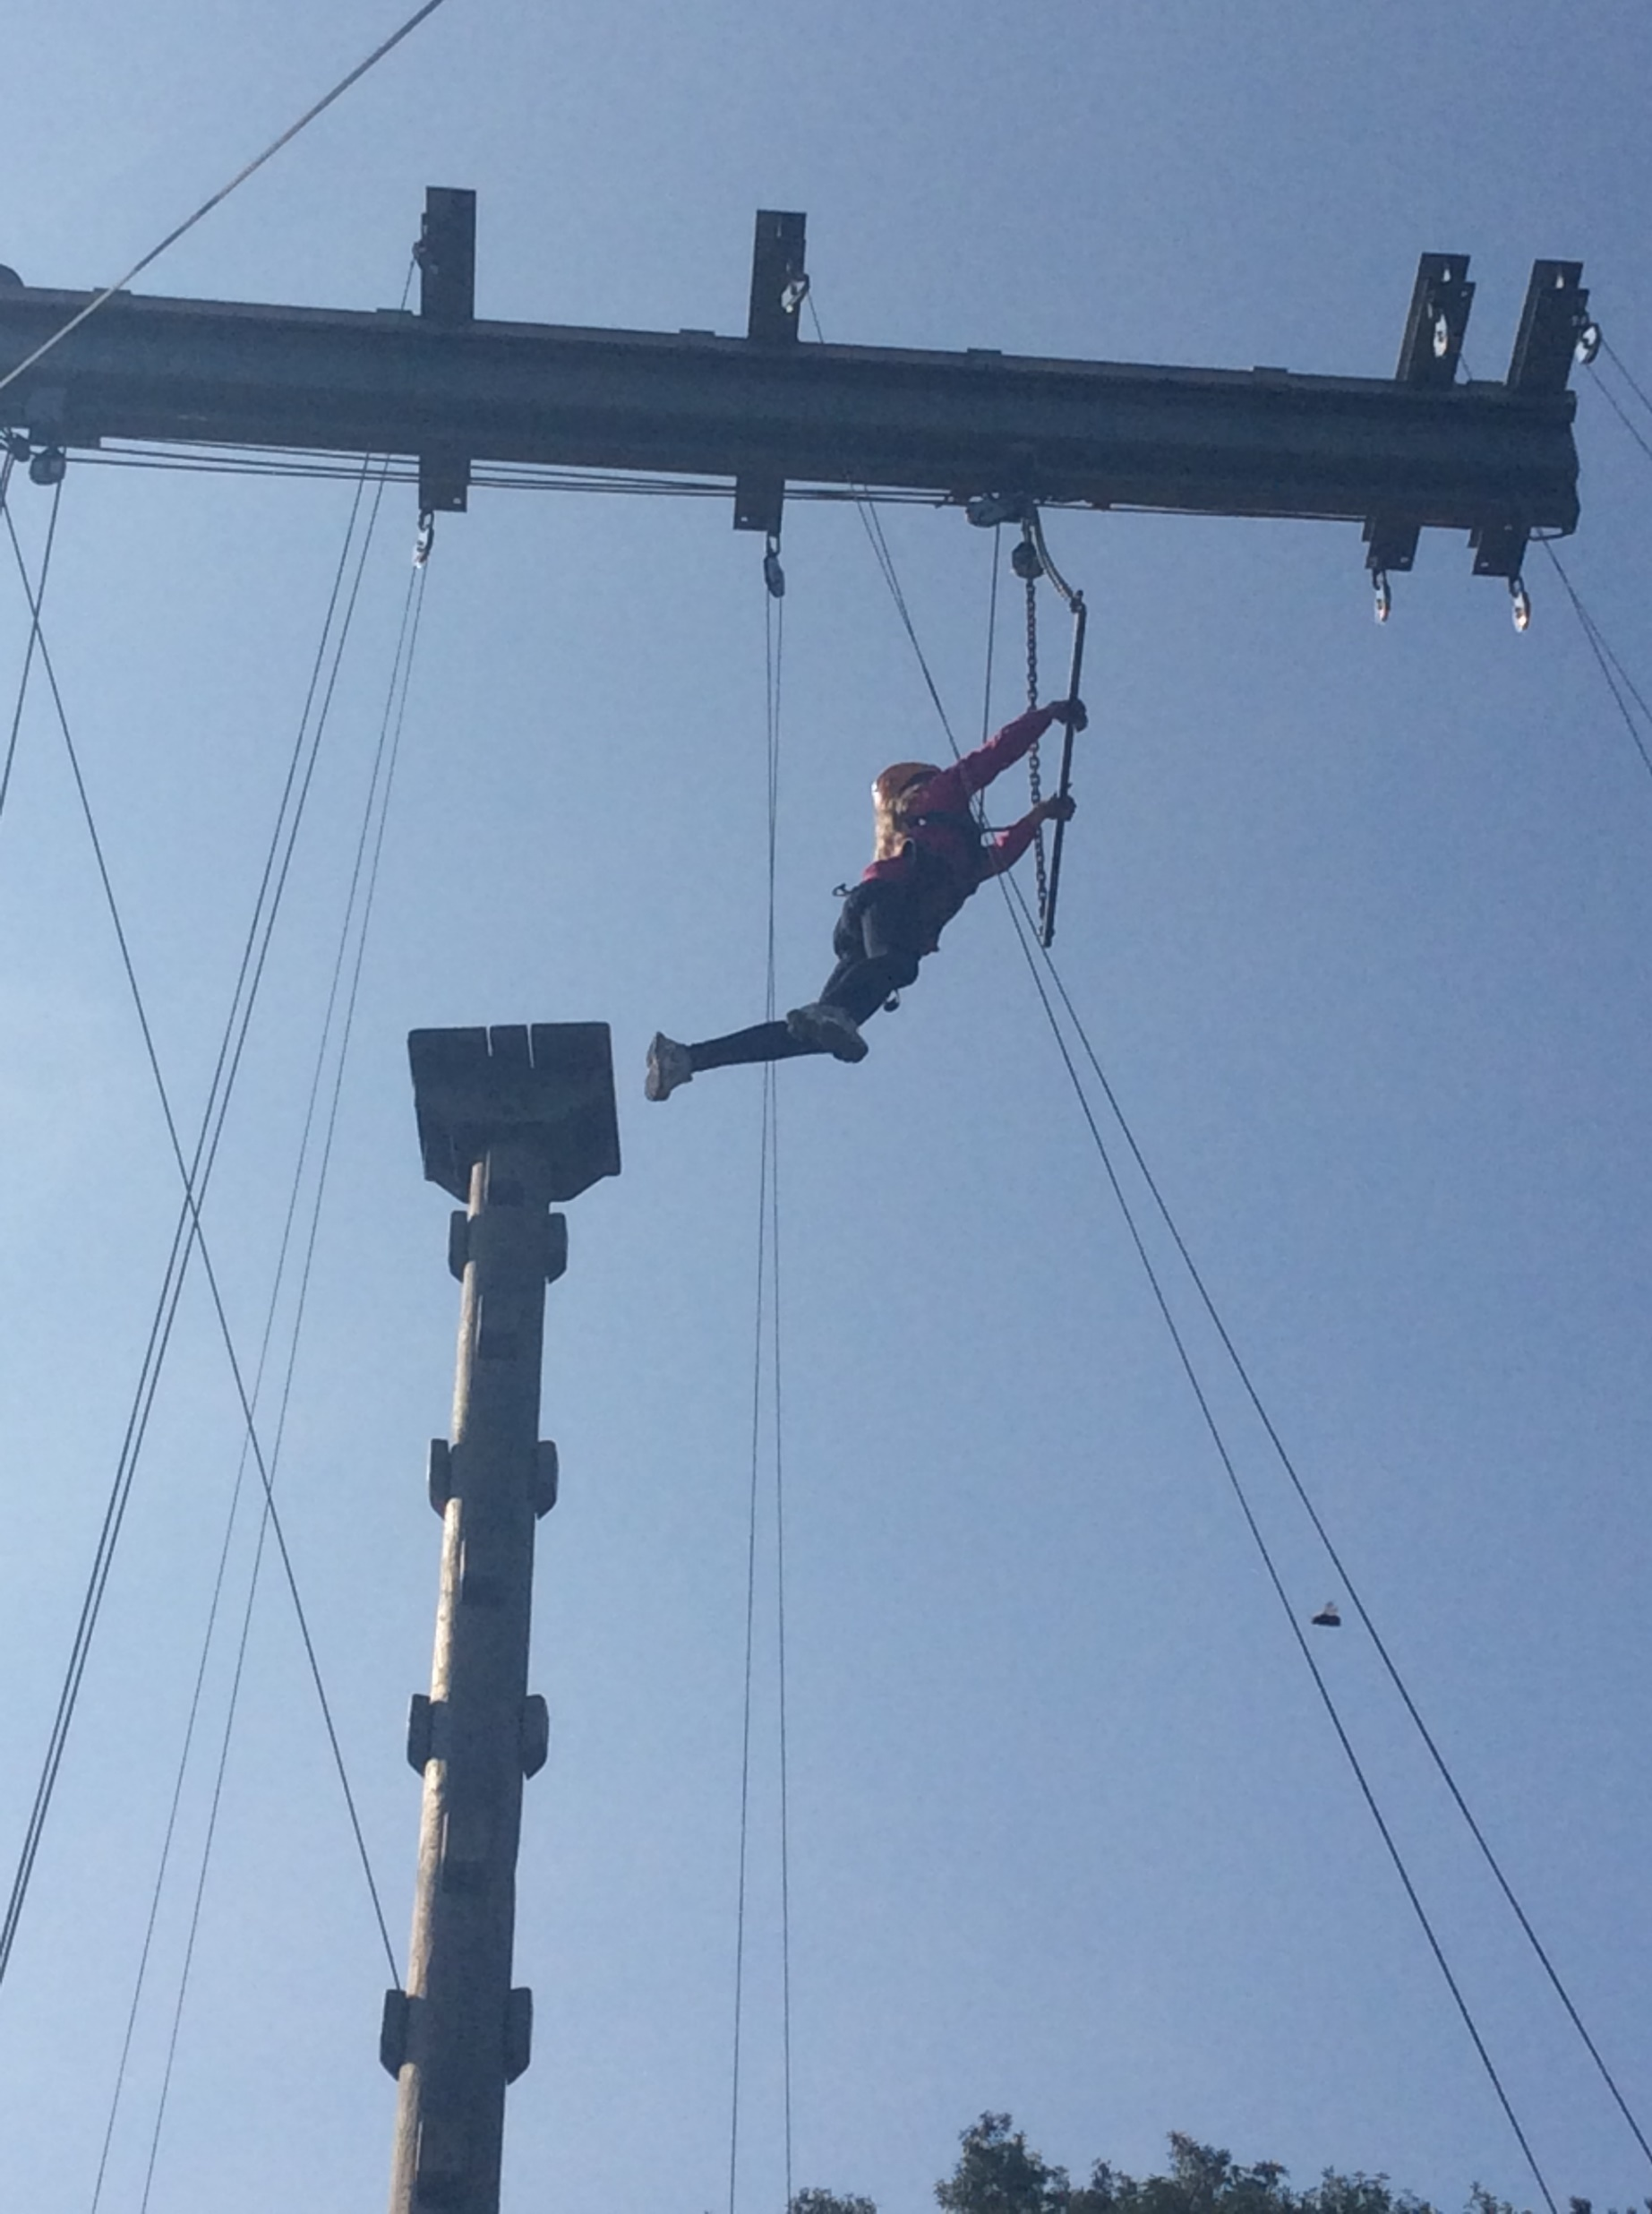
KINGSWOOD 2021
Q?

